Slide 1
COS 326 Database Systems
Lecture 2
Object-oriented Databases (1)
Chapter 12 (7th edition)
Thursday 25 July 2024

Slide 2
In this lecture
Introduction to OODBMSs
Limitations (‘weaknesses’) of Relational DB systems
Storing Objects in Relational Databases
OODB and OODBMS
Commercial & Open-Source OODBMSs
Alternative strategies for OODBMSs

Slide 3
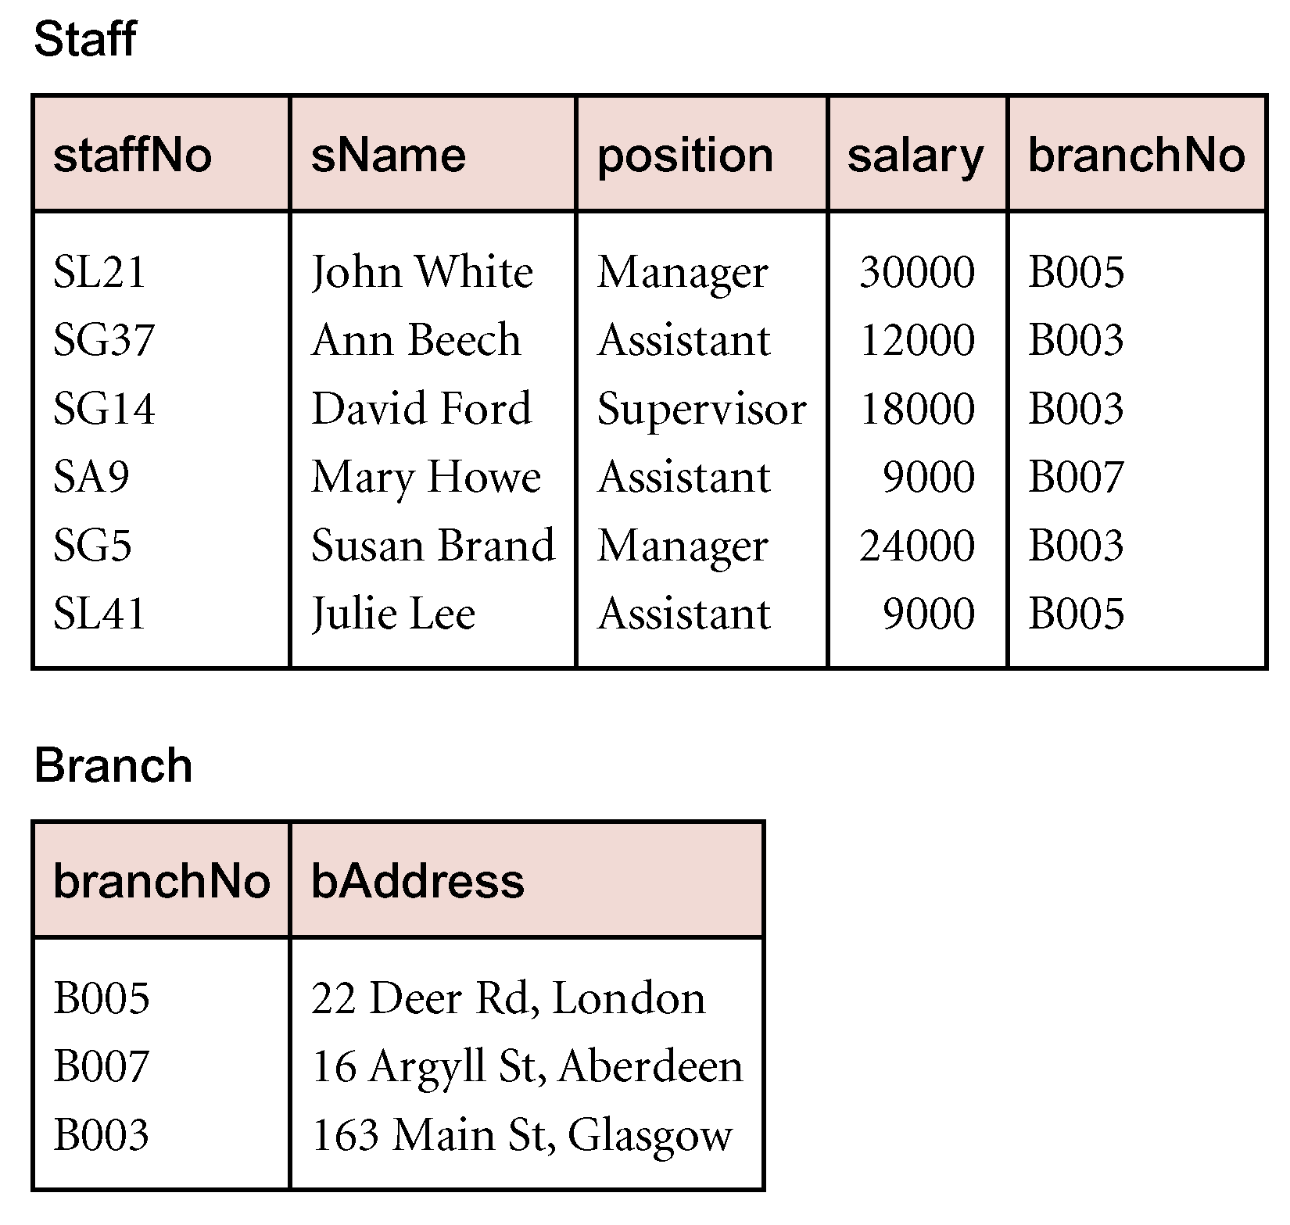
Limitations (‘weaknesses’) of RDBMSs (1)
1. Poor representation of “real world” entities
Normalization leads to relations that do not correspond to entities in the “real world”
Fragmentation of the “real world”
Information is most commonly obtained from the DB through performing a join (intensive computation) of 2 or more tables
e.g. JOIN required to see branch address together with staff member’s name
© Pearson Education Limited 1995, 2005

Slide 4


Limitations (‘weaknesses’) of RDBMSs (2)
2. Semantic Overloading
Single construct for representing data and data relationships: the relation
No mechanism to distinguish between relations & relationships or between different types of relationships
Relational model is semantically overloaded e.g. ERD
Student
Registration
Course
relationship
‘is written in’ is not recorded in Relational DB
relationship
‘is found in’ is
not recorded in Relational DB
This is a relation and a relationship
© Pearson Education Limited 1995, 2005

Slide 5
Limitations (‘weaknesses’) of RDBMSs (3)
3. Limited Operations
RDBMSs only have a fixed set of operations (using SQL) which cannot be extended
i.e. operations on sets of tuples as defined in the Relational calculus & algebra
Not possible for software developers to specify new operations
this is in contrast to OOP methods
BUT
Database programmers can create stored procedures on the server side.
© Pearson Education Limited 1995, 2005

Slide 6
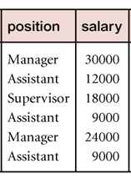
Limitations (‘weaknesses’) of RDBMSs (4)
4. Homogeneous data structure
Horizontal and vertical homogeneity is restrictive for ‘real world’ objects
Horizontal homogeneity
each tuple (row) composed of the same attributes
Vertical homogeneity
values of an attribute (column) come from same domain
Intersection of row and column must be atomic
cannot store an object that can be decomposed into its components
Note: can store a BLOB or CLOB (pointer to a file containing object) for viewing purposes

Slide 7
Limitations (‘weaknesses’) of RDBMSs (5)
5. Impedance
Physics
a measure of the opposition (resistance) to the flow of a current in an electrical circuit (I = V / R)
Software engineering
a measure of the opposition (difficulty) caused by differences between two programming paradigms
Embedded SQL
for applications that access database data
SQL standard provides embedded SQL
creates problem of impedence mismatch for software developers: Mixing different programming paradigms

Slide 8
Limitations (‘weaknesses’) of RDBMSs (6) e.g.Database application - JDBCSample.java
import java.sql.*
public class JDBCSample {
public static void main( String args[ ]) {
String connectionURL = "jdbc:postgresql://localhost:5432/movies;user=java;password=samples";
try {
Class.forName("org.postgresql.Driver");
Connection con = DriverManager.getConnection (connectionURL);
Statement stmt = con.createStatement();
ResultSet rs =
stmt.executeQuery("SELECT moviename, releasedate FROM movies");
while (rs.next())
System.out.println("Name= " + rs.getString("moviename")
+ " Date= " + rs.getString("releasedate");
}
finally { con.close(); }

Slide 9
Limitations (‘weaknesses’) of RDBMSs (7)
6. RDBMS supports short-lived transactions
Transaction is: an indivisible sequence of DB operations
e.g BEGIN TRANSACTION
SQL statements for transaction go here
END TRANSACTION
Short-lived (business) vs long-duration (design)
7. Schema changes create problems
Database change requires program changes
e.g. of change: add new attributes (columns) to a table

Slide 10
Storing Objects in Relational Databases
Storing objects in relational DB:
An approach to achieving persistence with an OOP language:
use RDBMS as underlying storage engine
Mapping class instances (i.e. objects) to one or more rows distributed over one or more relations
write code to convert between objects and rows
UN-NECESSARY WORK THAT CAN BE AVOIDED
e.g. a STUDENT registers for COURSES for a DEGREE
PROGRAM
=> The data for a STUDENT object is stored in 3 tables
© Pearson Education Limited 1995, 2005

Slide 11
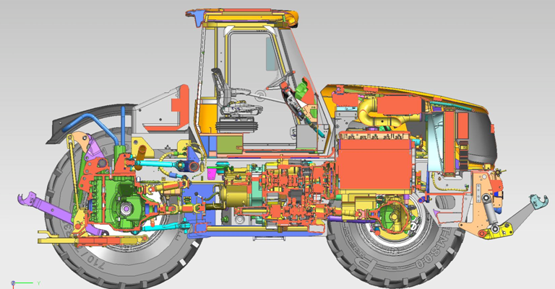
Object-oriented Databases (1)
Some common characteristics for design data:
design has many parts & interdependent subsystems
large number of types & small number of instances cf. relational: few relations, many tuples
Originates from Engineering
& design domains
e.g. CAD (Computer Aided Design) database stores data relating to engineering designs
e.g. of designs
(1) Cars
(2) Buildings
Using AutoCAD, Revit, etc.
OODMS market is small compared to RDBMS market

Slide 12
Object-oriented Databases (2)
Object databases (ODB)
Object data management systems (ODMS)
Meet some of the needs of more complex applications
Specify:
Structure of complex objects
Operations that can be applied to these objects

Slide 13
Object-oriented DB Terminology
OO data model
(logical) data model that captures the semantics of objects supported in object-oriented programming
OO database
persistent sharable collection of objects defined by an OO data model
OODBMS
manager (software) of an OODB

Slide 14
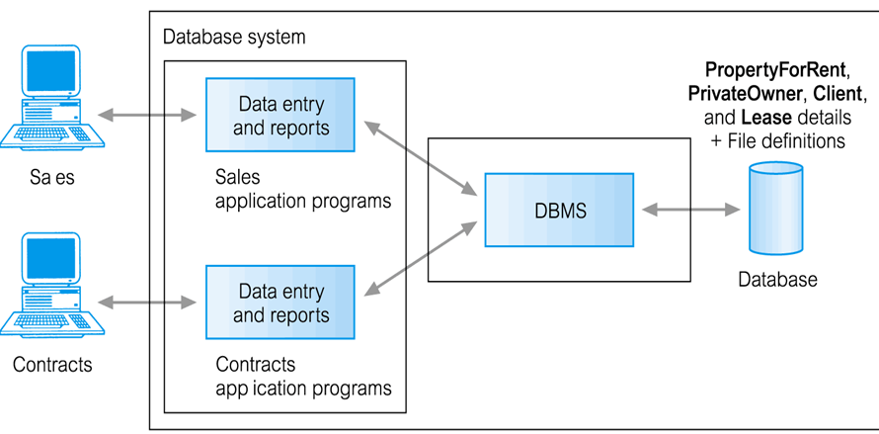
OODB and OODBMS
OO data model defines contents of OODB
Object-oriented DBMS (OODBMS)
Object-oriented database (OODB)
OO data model
(logical) data model that captures the semantics of objects (classes) supported in object-oriented programming

Slide 15
OODBMSs
Commercial
GemStone from Gemstone Systems Inc.
Objectivity/DB from Objectivity Inc.
ObjectStore from Progress Software Corp.
Open source
ZooDB (by Tilmann Zäschke)
ObjectDB (by ObjectDB Corp)
ConceptBase (by University of Skövde)
© Pearson Education Limited 1995, 2005

Slide 16
Strategies for developing an OODBMS
Extend existing object-oriented programming language
add traditional database capabilities to existing OOP language,
e.g. Smalltalk, C++, Java
e.g. GemStone extended Smalltalk, C++, Java
Provide extensible OODBMS library
No extensions to the OOP language
provide off-the-shelf library
Library provides persistence and database capabilities
Work in known programming language with same compiler
examples are: ObjectStore (for C++) and ObjectDB(for Java)
© Pearson Education Limited 1995, 2005

Slide 17
Strategies for developing an OODBMS
Reading for student
3. Imbed OODB language constructs in conventional host language: e.g. O₂ : extensions for C
Extend existing database language (SQL) with object-oriented capabilities
SQL (1999) by ISO supports OO features
Object SQL standard by ODMG
Ontos and Versant provide a version of Object SQL
Develop novel database data model/language
No history / baggage, start from scratch
No installed base, no skills
Semantic Information Manager (SIM)
© Pearson Education Limited 1995, 2005

